Slide 1
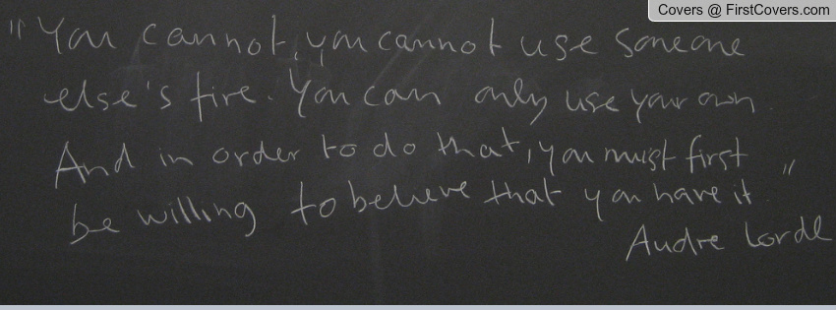


AUDRE LORDE

Slide 2
GOALS
Understand Audre Lorde’s life and writings as a blueprint for modern struggle
Evaluate intersections of resistance for black, brown, feminist, anti capitalist, trans movement
Learn about legendary leaders from the movement and how are you currently contributing to civil rights legacy

Slide 3
AGENDA
Welcome & Check-in: Litany of Survivial
Who was Audre Lorde
Discussion
Closing Activity

Slide 4
LITANY OF SURVIVIAL
Read aloud Audre Lorde’s Litanty of Survival
Take turns reading one line until we finish the poem
How are you living in the example of Audre Lorde?

Slide 5
AUDRE LORDE
The Erotic as Power
There is No Hierarchy of the Oppressed

Slide 6
DISCUSSION
What lessons does Audre Lorde teach us about the concept of intersectional movement building?
How does she inspire you to be more powerful?
What does she say that speaks to the current condition of LGBTQ+ youth and youth of color?
How does her work and life inspire you to dismantle the current system of mass incarceration, state violence, and the school to prison pipeline?

Slide 7

✪ LITANY OF SURVIVAL
  Create your own artistic expression of your “Litany of Survival” in using art, theatre, music, etc.
Notes:
This is a pair share activity.

Slide 8
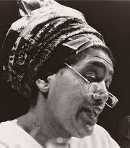
“It is not our differences that divide us. It is our inability to recognize, accept, and celebrate those differences.”
-Audre Lorde

Slide 9
THANK YOU

